Slide 1
Project Planning & Initiation
Notes:
peritia is a Perth-based project management company since 2003.
peritia works across a range of industries including Information Technology focussing on adding value to project-led companies.
Yvonne Parle is a Senior Consultant at peritia. She has worked in Information Technology, management and business analysis for over 20 years in the U.K., the U.S., Australia and Europe.

Slide 2
Time and projects
Project start
Project end
time
Phase
Phase
Phase
Phase

Slide 3
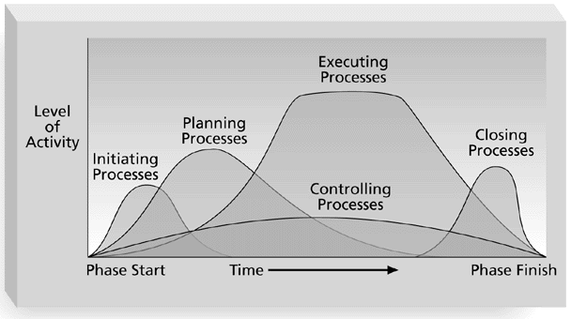
Overlap of Process Groups in a Phase
(PMBOK® Guide, 2000, p. 31)

Slide 4
Project Definition (Buttrick 2000)
If you don’t know why you are doing the project, consider terminating it
If you don’t know what you are delivering, regard your costs and timescales as unstable and your risk high
If you don’t know when it will be done, carry out more investigations until you do
If you don’t know how you will approach the project, regard risk as high and investigate further
Notes:
Successful projects are built on people so are failed ones!
Project Manager is the person responsible for managing a project (PMBOK) – who then is responsible for LEADING a project? (Project Leadership is about establishing direction, aligning people and motivating & inspiring)
Organisational culture, national culture – influence on communication and problem solving
High resource versus low-resource (or no-resource) settings?

Slide 5
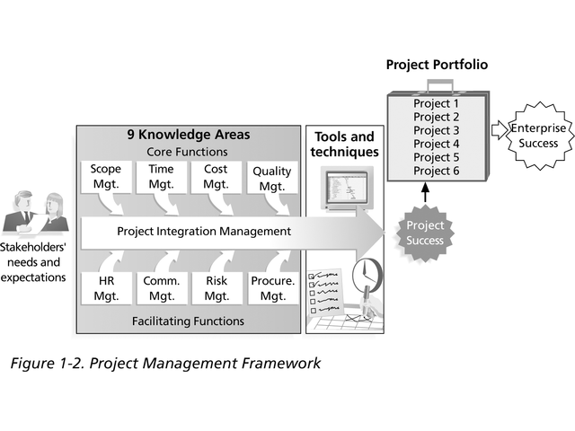
9 Knowledge Areas

Slide 6
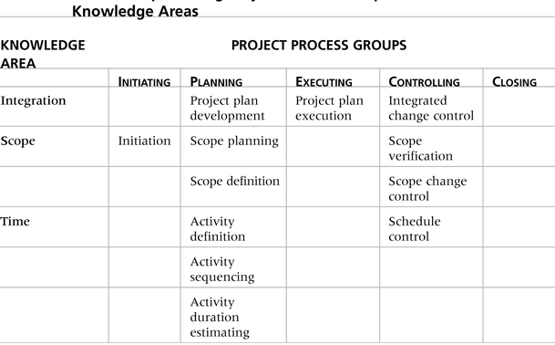
Relationships Among Process Groups & Knowledge Areas
(PMBOK® Guide 2000, p. 38)

Slide 7
Project Initiation
Initiating a project includes recognizing and starting a new project or project phase
Some organizations use a pre-initiation phase, while others include items like developing a business case as part of initiation
Main goal is to formally select and start off projects
Key outputs include:
Assigning the project manager
Identifying key stakeholders
Completing a business case
Completing a project charter & getting signatures on it

Slide 8
Question
What is a stakeholder?
What is it important to identify all of the stakeholders?

Slide 9

Example stakeholders

Slide 10
Stakeholders
List stakeholders
Consider external groups, internal groups, other projects, people groups, partners
Identify their stake (or interest)
Stakeholder
Interest

Slide 11
Stakeholder analysis map
Buy-in
Address concerns
Ownership
Address concerns &
active involvement
High
Awareness
Keep informed
Buy-in
Some involvement required
Impact on stakeholder
Low
High
Degree to which they are critical to the success of project

Slide 12
Project Initiation Documents
Every organization has its own variations of what documents are required for project initiation.
It’s important to identify the need for projects, who the stakeholders are, and what the main goals are for the project

Slide 13
Project Planning & Initiation
“If you plan for nothing – you will surely get there”
Define the job in detail
Get the right people in the right roles
Estimate the time and costs
Break the job down into smaller tasks
Develop project standards
Establish a change procedure
Agree on Acceptance criteria
Notes:
Break the project down into deliverable products where XX equals no more than 10, 20, 30 or 30 hours to complete.
HOW WILL THE DELIVERABLES ASSIST WITH REPORTING LATER ON?

Slide 14
Activities in the planning phase
Integration
Project plan development
Scope
Scope planning, scope definition
Time
Activity definition, activity sequencing, activity duration, estimating, schedule development
Cost
Resource planning, cost estimating, cost budgeting

Slide 15
Activities in the planning phase
Quality
Quality planning
Human Resource
Organisational planning, staff acquisition
Communications
Communications planning
Risk
Risk management planning, risk identification, qualitative risk analysis, risk response planning
Procurement
Procurement planning, Solicitation planning

Slide 16
Detailed planning approach 90% planning, 10% execution
Why do I need to write it up?
CTRs (Cost, Time, Resource sheets)
XX Hour Rule – no task should be more than 30 hours.
CTRs are used as
Checklist for completeness
Clear communication document
Input to Kick off Meeting
Progress reporting
Notes:
CTRs are generally prepared as a team effort – generating debate resulting in fine-tuning and better accuracy in estimation and better definition of deliverables and risk.

Slide 17
Project Planning 90% planning, 10% execution
The main purpose of project planning is to guide execution
Every knowledge area includes planning information (see Table 3-5 on pages 79-80)
Key outputs include:
A team contract
A scope statement
A work breakdown structure (WBS)*
A project schedule, in the form of a Gantt chart with all dependencies and resources entered*
A list of prioritized risks*

Slide 18
Question
Why is a scope statement critical?
If you were organising a party, what is in scope and what is out of scope.

Slide 19
Work Breakdown approaches
Using guidelines
Analogy
Top down
Bottom up
Mind-mapping

Slide 20
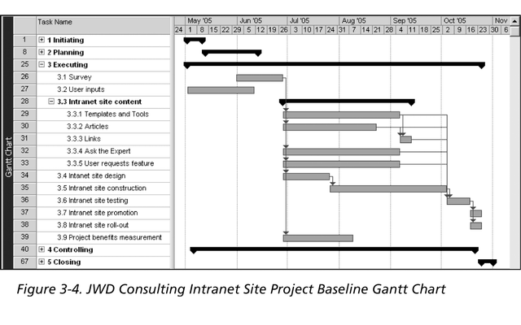
Example Project Gantt Chart

Slide 21
Question
For a party:
Use mind-mapping method to produce a WBS.
Use the top-down approach
Use the bottom-up approach

Slide 22
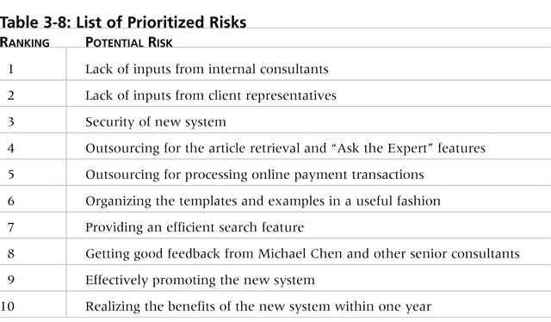
Example List of Prioritized Risks

Slide 23
Activity
List all of your risks for the project.
Identify the top 5

Slide 24
Project Checklist
Has a project definition been written, reviewed by the stakeholders and approved by the project sponsor
Have the benefits been fully assessed and quantified wherever possible
Do the benefits match the needs?
Have all the risks been identified and categorized?
Has a comprehensive and satisfactory work breakdown been developed?
Does the work breakdown reflect the deliverables to be produced?
Are all key logical relationships between projects and activities clear?
Has the plan been developed to minimize or offset the risks?

Slide 25
For each deliverable, check
Are the project deliverables relevant and are they feasible both to produce and implement?
Have quality criteria been established?
Is it clear who is accountable for preparing each deliverable?
Is it clear who will review the deliverable prior to signing off acceptance of each deliverable?
Is it clear who will sign off each deliverable?
Has sufficient time been allowed for reviewing/amending each deliverable?

